Slide 1

CS+Social Good
Define

Slide 2
Recap
Last week:
Empathized with people in a problem space.
Interviewed one or more people
Observed people
Read people’s stories/perspectives of the situation
Immersed yourself in their situation by looking for resources/communities they have (i.e. facebook groups, etc.)
SHARE: What is something you learned? Something new you experienced?
Notes:
5 minutes

Slide 3
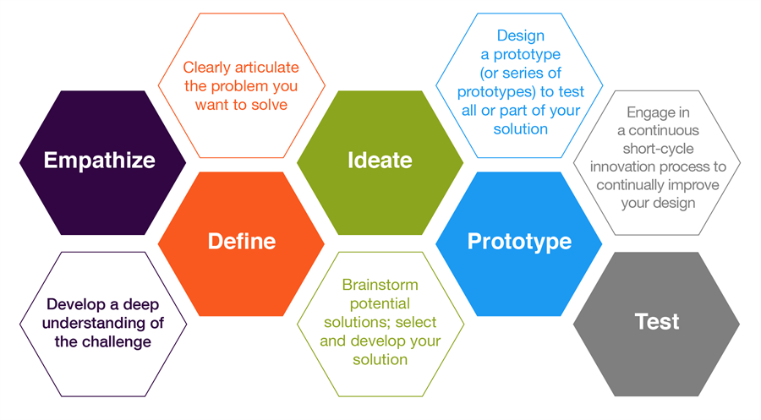
Design Thinking
Notes:
Transition from steps:

Slide 4

Define the problem you want to solve
This step in the process is when you unpack and synthesize your empathy findings into compelling needs and insights and try to focus on a specific and meaningful challenge.
Goals:
Develop a deep understanding of your users and the design space
Use that understanding to come up with an actionable problem statement and your unique design vision
Notes:
Empathy → inferences from observations → insights about users → defining a problem
specific users, and insights and needs

Slide 5
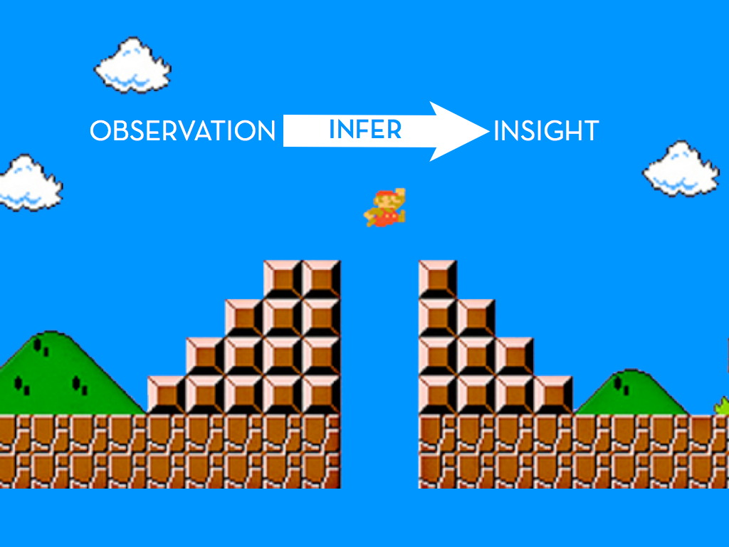
Notes:
You’re at the observation phase -- you’ve empathized. Now, you have to infer needs from that observation (you may have already identified some), and leap to insights. This will help you define the problem you’re trying to solve. (If students have already thought of a problem, tell them to put away that thought for a moment, and try the activity; likely, they will end with the same problem, but this will make them think more critically in the process).

Slide 6
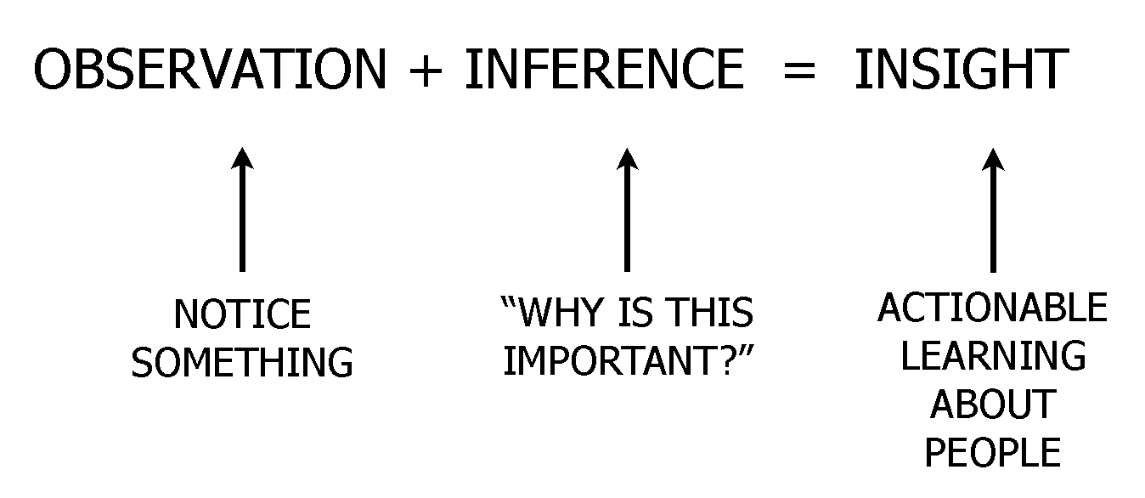
Define - Drawing conclusions from Empathy
Notes:
Emphasize below comment about inference:
Observation: What you did with your community partners
Inference: How can you generalize the information from your interview/observations/etc. to identify the needs, wants, and motivations of the person you’re designing for?
Insight: How can you apply design thinking to meet the needs of your person?

Slide 7
Define - the process
WE GOT TO KNOW...
(a user you were inspired by)
WE WERE AMAZED TO REALIZE…
(a new insight)
IT WOULD BE GAME-CHANGING TO…
(solve X problem)
Notes:
Make sure on the last bullet to stress they’re identifying what problem could be solved

Slide 8
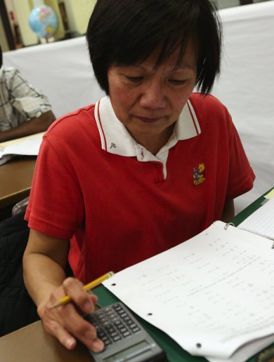
Example
WE GOT TO KNOW...
Tiwan, a 40 year old GED student, who struggles to find work
WE WERE AMAZED TO REALIZE…
The huge range of things she does to save money and her optimism for the future.
IT WOULD BE GAME-CHANGING IF…
She could visualize the many strands of “money saving” she does and thus prioritize her efforts
Notes:
Make sure to emphasize that the game-changing thing is defining a problem -- you’re not so much focused on solving it, but rather identifying what could be solved

Slide 9
Your turn: Who did you meet?
WE GOT TO KNOW...
(a user you were inspired by)
WE WERE AMAZED TO REALIZE…
(a new insight)
IT WOULD BE GAME-CHANGING TO…
(solve X problem)
Notes:
5 min -- can do this for more than one person if you met more than one person

Slide 10

Share!
What were your findings?
Notes:
3 min

